Slide 1








Gene Expression
Explorer
Team Name: TJ Squard
Created By:
TojinVakey Simson & Jaiby Mariya Joseph

Slide 2
Problem Statement
Challenge:
There is a vast amount of genomic data available in public repositories, such as NCBI GEO. However, this data is often difficult to interpret without deep knowledge of bioinformatics. The challenge is not just accessing this data, but effectively analyzing and interpreting it to derive meaningful insights that can contribute to research or clinical applications.
Key Issues:
Difficulty in Differentiating Between Healthy and Diseased Gene Expression:
One of the core challenges in genomics research is identifying the differences in gene expression profiles between healthy and diseased states. Despite the availability of datasets, it is challenging to identify these differences without advanced statistical tools or knowledge.
Lack of User-Friendly Tools for Non-Experts:
Many existing tools are too complex or require specialized knowledge of bioinformatics, programming, and data analysis. This limits access to crucial insights for a broad range of users, including clinicians, educators, and researchers from non-computational fields.

Slide 3
Limited Integration of Analysis and Visualization:
Existing solutions often split the process of data analysis and visualization into separate tools, requiring users to switch between multiple platforms. This can be time-consuming and may lead to errors or misinterpretations.
Impact:
Due to these barriers, a lot of valuable insights remain untapped in public genomic data. Researchers, educators, and even clinicians face difficulties in leveraging these datasets effectively, hindering advancements in understanding diseases and discovering new biomarkers.

Slide 4


Our Solution- At a Glance
Solution Overview:
Gene Expression Explorer is a web-based platform that simplifies the process of analyzing and visualizing gene expression data, making it accessible to both bioinformatics experts and those with little computational background. The tool bridges the gap between raw genomic data and meaningful biological insights.
Core Features:
Data Upload:
Easy upload of RNA-seq or microarray data from public repositories like NCBI GEO.
Differential Gene Expression (DEG) Analysis:
Automatic DEG analysis to compare gene expression between healthy and diseased samples using established statistical methods.
Interactive Visualizations:
Intuitive visualizations (volcano plots, heatmaps, PCA plots) to explore gene expression patterns across samples.
Gene Query:
Search and explore specific genes of interest, and view their expression levels across various conditions or samples.

Slide 5
Abstract
Overview
Key Functions:
Gene Expression Explorer is a user-friendly, web-based platform designed to facilitate the analysis of gene expression data, particularly from NCBI GEO, to compare gene expression between healthy and diseased samples. The tool simplifies the traditionally complex process of genomic data analysis and visualization. Objective:
The primary goal of Gene Expression Explorer is to make the process of gene expression analysis more accessible, user-friendly, and interactive, empowering researchers and clinicians to derive meaningful insights from genomic data without needing advanced bioinformatics expertise.
Upload Gene Expression Data: The tool allows users to easily upload RNA-seq or microarray data, streamlining the process of data integration.
Statistical Analysis: Built-in statistical tools perform differential gene expression analysis, identifying genes that show significant differences in expression between conditions (healthy vs diseased).
Visualization: The platform generates interactive visualizations, such as volcano plots, heatmaps, and PCA plots, that enable users to quickly grasp gene expression patterns and understand their biological significance.

Slide 6
Technical Approach
Data Integration and Preprocessing
Differential Gene Expression (DEG) Analysis
Seamlessly integrates public datasets from NCBI GEO, supporting RNA-seq and microarray formats.
Automated data preprocessing pipeline includes normalization (e.g., TPM/RPKM for RNA-seq), filtering low-expressed genes, and imputing missing values, ensuring clean and consistent input for downstream analysis.
Employs robust statistical tests (e.g., moderated t-tests, DESeq2 methods) to identify genes significantly differentially expressed between healthy and diseased samples.
Provides ranked gene lists with adjusted p-values and fold-change metrics.
Machine Learning Integration
Interactive Visualization Module
Implements Random Forest and Support Vector Machines (SVM) for classification of samples (healthy vs diseased) based on expression profiles.
Uses Recursive Feature Elimination (RFE) and Lasso regularization to select the most informative genes, reducing dimensionality and improving model interpretability.
Applies Principal Component Analysis (PCA) for dimensionality reduction and visualization of sample clusters.
Dynamic volcano plots, heatmaps, and PCA scatter plots that allow users to explore gene expression trends interactively.
Gene query interface enables users to track expression of specific genes across conditions without needing coding skills.

Slide 7
Web Application Layer
Built with a responsive frontend framework (React.js) providing an intuitive UI for uploading datasets, running analyses, and visualizing results.
Backend powered by Python (Flask/Django) managing data processing, statistical analysis, and machine learning model serving.
Database support (MongoDB) for storing user queries and processed results.
RESTful APIs enable modularity and potential integration with other bioinformatics tools.

Slide 8
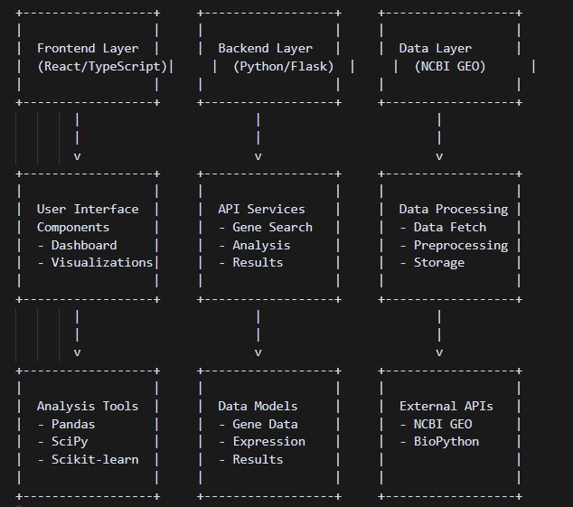
System Architecture
Data Flow:
1. User Interface - Users interact with the web interface - Submit gene queries and analysis requests - View results and visualizations.
2. Backend Processing - Handles API requests - Manages data processing pipeline - Coordinates with external services.
3. Data Management - Fetches data from NCBI GEO - Processes and stores gene expression data - Manages analysis results.
4. Analysis Pipeline - Differential expression analysis - Statistical processing - Machine learning classification.
An exploraion of innovations

Slide 9
Automated Data Pipeline: Unlike existing tools, our platform automates raw data processing from GEO datasets, reducing the manual overhead for researchers.
Impactful Modifications and Innovations
Integrated Machine Learning Models: The addition of ML classifiers that predict disease status based on gene expression is a novel enhancement, bridging raw data analysis with predictive biology.
Interactive Gene Query Interface: Enables non-programmers to perform gene-specific investigations, lowering the technical entry barrier.
Modular and Scalable Architecture: Microservice-friendly design allows easy incorporation of future data types (proteomics, metabolomics) and analytics.
Real-time Visualization Updates: Immediate feedback on analysis through dynamic plots improves exploratory data analysis efficiency.

Slide 10
Feasibility and Expected Real-World Impact
Feasibility:
Expected Real-World Impact
Technical Feasibility: The use of well-established open-source libraries and frameworks (scikit-learn, Plotly, Flask) ensures that the solution is implementable with current technology. GEO datasets provide ample, high-quality data for development and testing.
Operational Feasibility: Designed for ease of use by non-expert users, the web-based UI simplifies complex genomic analyses without requiring programming skills.
Scalability Feasibility: Cloud deployment and containerization (Docker) allow the platform to handle increasing data volumes and user traffic efficiently.
Accelerate Biomedical Research: Enables researchers and clinicians to rapidly identify key genes associated with diseases, potentially speeding up biomarker discovery and therapeutic target identification.
Lower Barrier to Genomic Analysis: Democratizes access to advanced gene expression analysis, empowering smaller labs and clinical practitioners without dedicated bioinformatics teams.
Support Personalized Medicine: By classifying patient gene expression profiles, the tool can aid in customized treatment strategies in the future.
Educational Resource: Can be used for training students and researchers in genomics and data science with hands-on interactive experiences.

